Slide 1
Student Management System
‘Professional Minds, Exceptional Future’
Presented By : )
Khushi Shukla

Slide 2
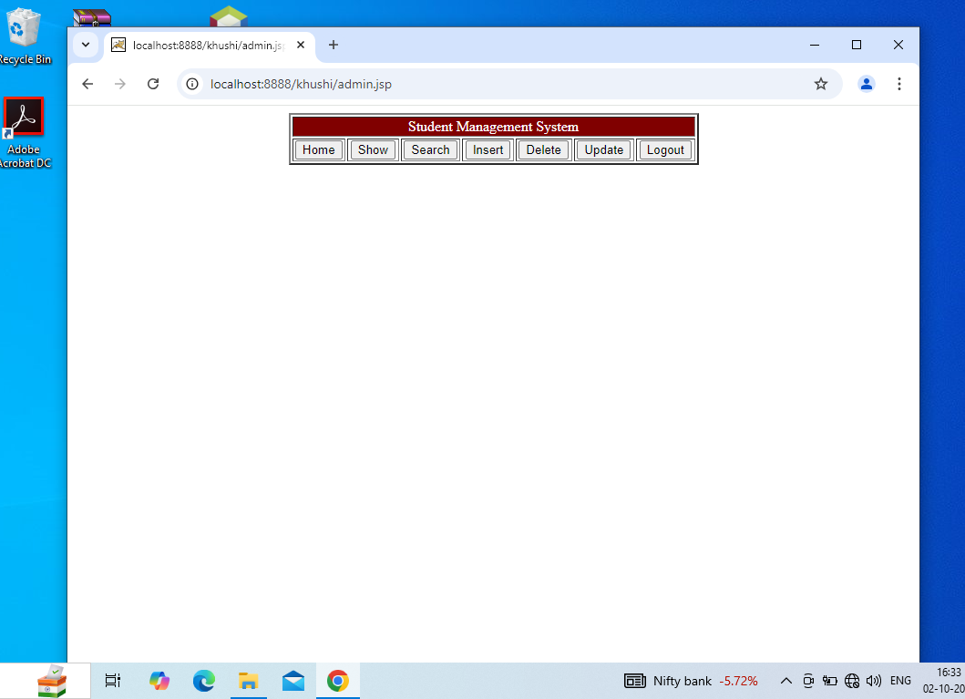
Home Page

Slide 3
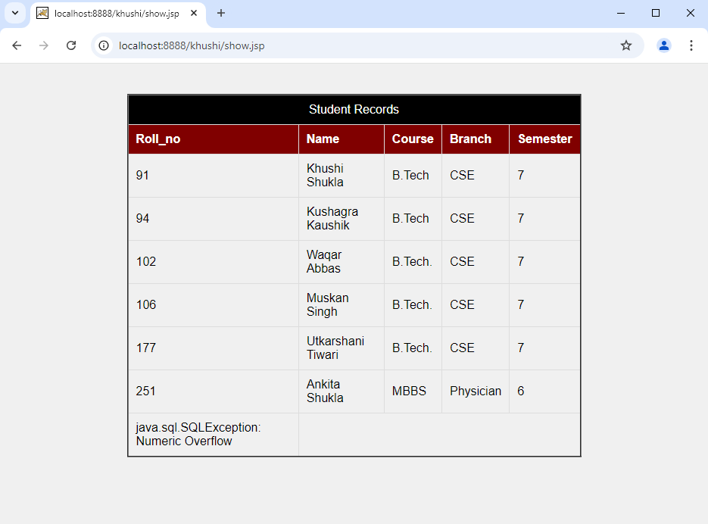
Display Page

Slide 4
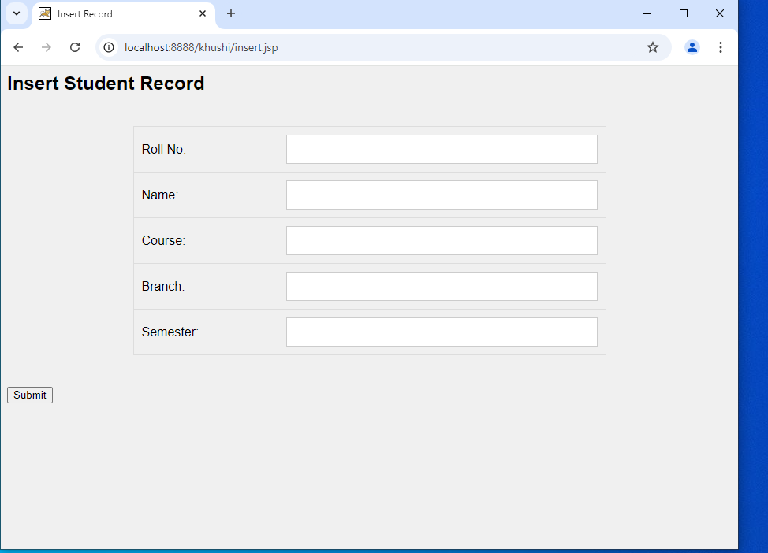
Insert Section

Slide 5
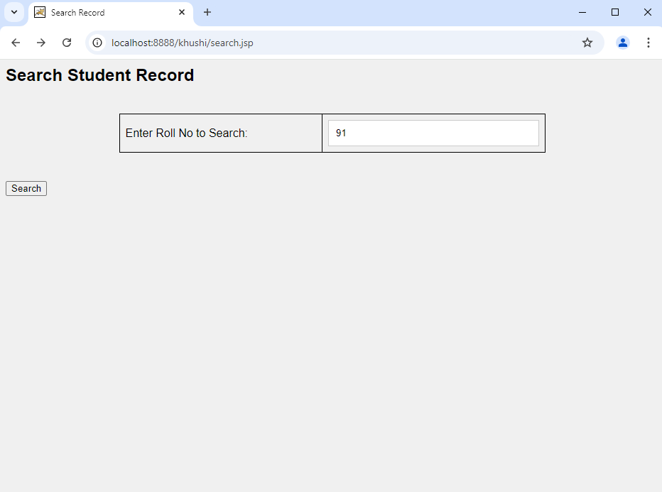
Search Section

Slide 6
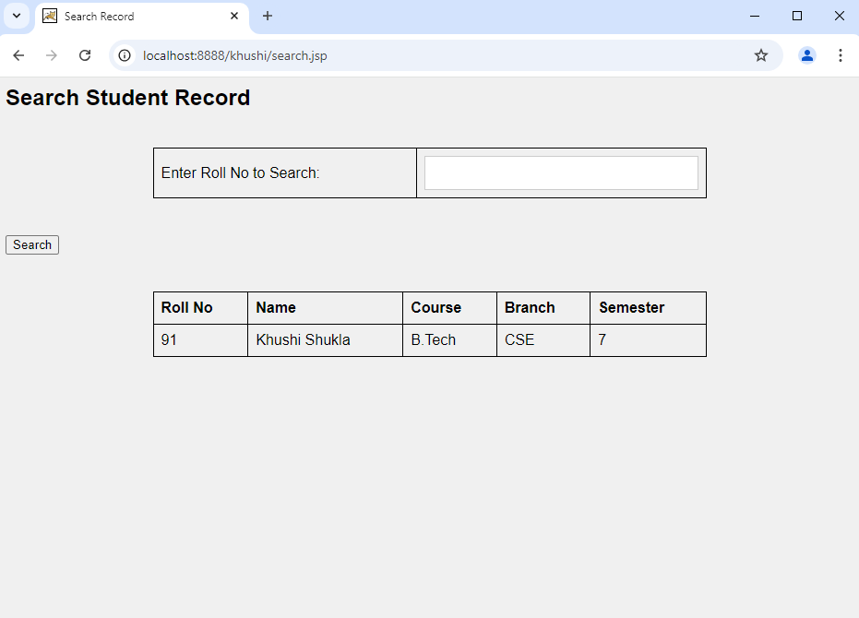
Search Result

Slide 7
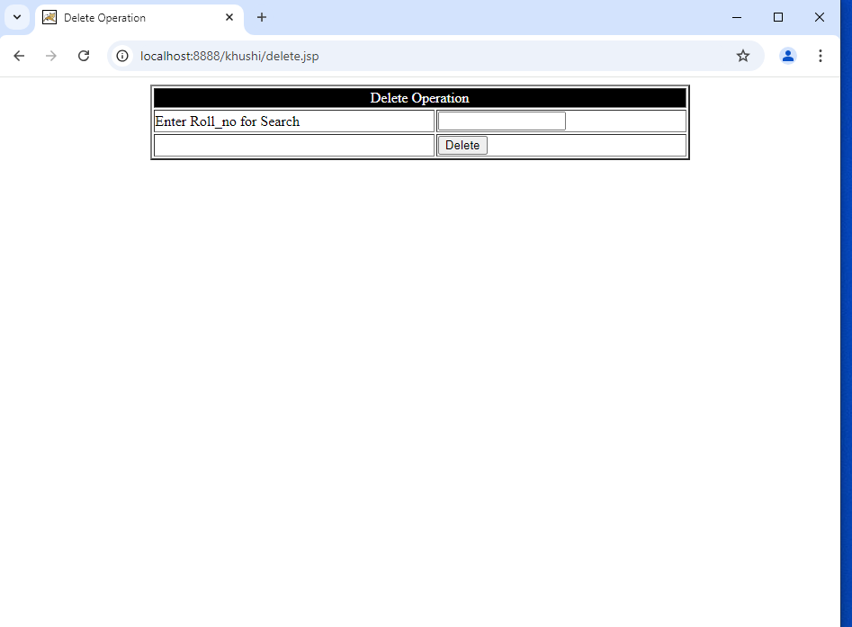
Delete Section

Slide 8
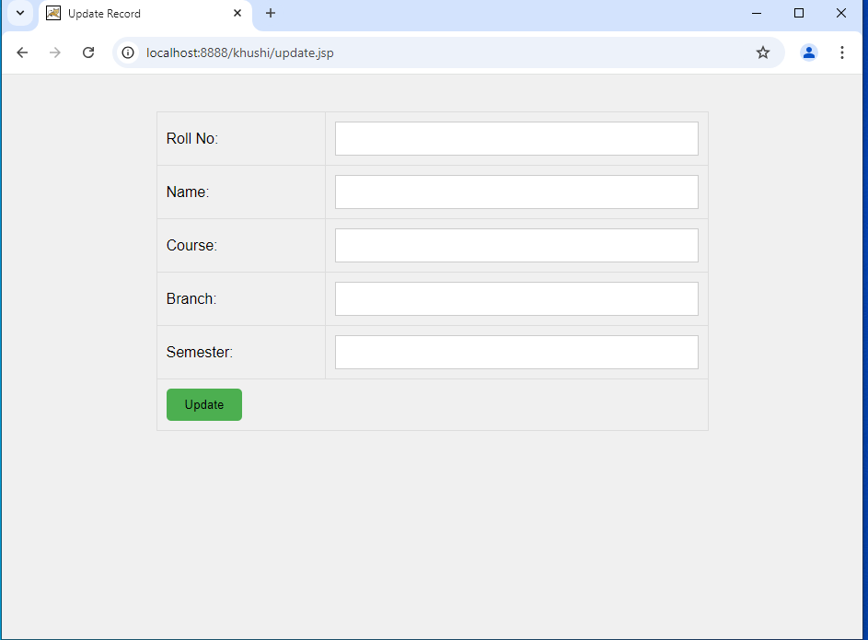
Update Section

Slide 9
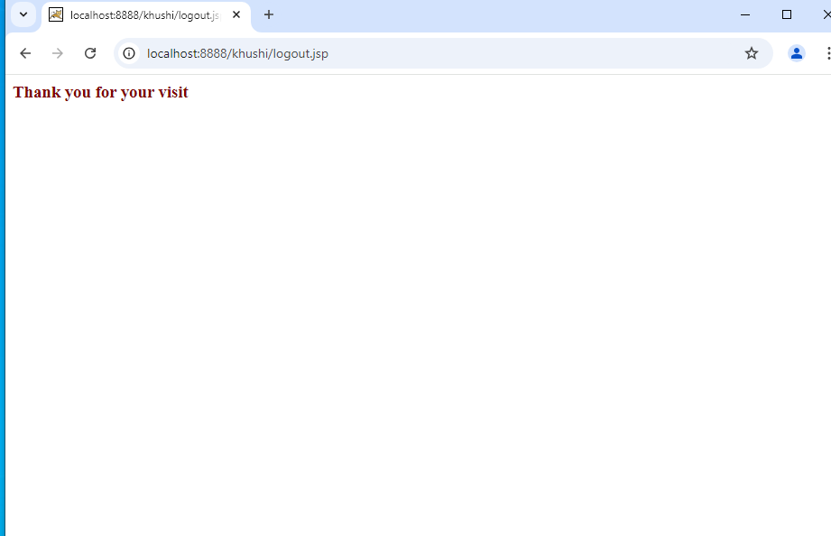
Log Out Section

